Slide 1
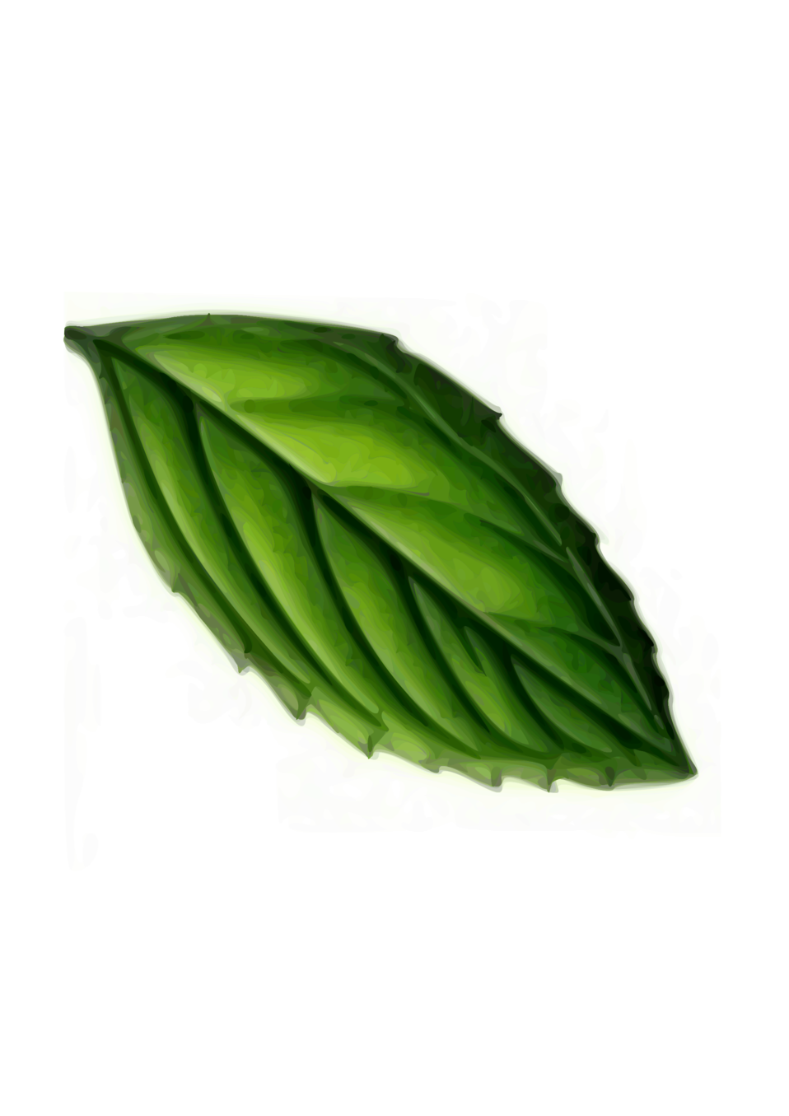
BASIL HERB
Bio-Automated System with Intelligent Lighting Hydroponics for Enhanced Rapid Bloom
Group 5

Slide 2
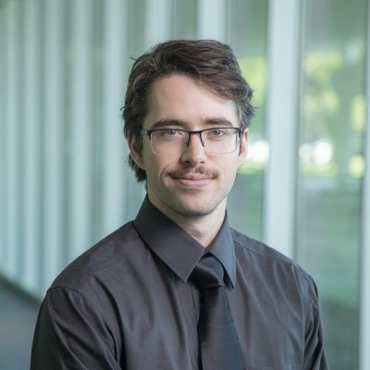
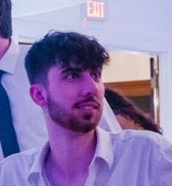
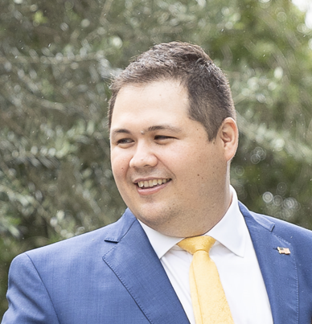

Intros
Casey O'Donahoe
Logan Voiselle
Justin Boyd
Justin Press
Computer Engineer
Computer Engineer
Electrical Engineer
Optical Engineer

Slide 3
Work Distribution
Creol | Tasks
Justin Press | Integration of LED lights
 | Color Sensor Selection and Integration
 | Sync Color Sensor Readings With Instructions
Electrical Engineering | Tasks
Justin Boyd | PCB Design
 | Water Pump Selection and Integration
 | Voltage Regulation
 | Water Level Sensor Selection and Integration
Computer Engineering | Tasks
Logan Voiselle | MCU Selection and Integration
 | Temperature/Humidity Sensor Selection and Integration
 | pH Sensor Selection, Calibration and Integration
 | Communication to Web App
Computer Engineering | Tasks
Casey O’Donahoe | Website Design and Management
 | Software Design and Management

Slide 4
Motivation
Background
Juggling busy schedules makes traditional gardening difficult for college students.
Many want to grow organic food for health and sustainability benefits.
Up to 50% of home-grown basil dies due to inadequate care.
U.S. organic food sales hit $50.1 billion in 2019.
31% of college students struggle with maintaining a healthy diet due to time constraints.
Advances in photonics, engineering, and computer science have enabled smart greenhouses as a solution.
The global smart greenhouse market is projected to reach $2.1 billion by 2025.
Our goal: develop an intelligent greenhouse system empowering busy individuals to grow organic herbs.

Slide 5
Goals
Basic Goals:
Monitor and maintain optimal growing conditions
Implement efficient hydroponic system
Develop web app for data analysis and user interaction
Design portable, safe home setup
Advanced Goals:
Integrate optimal LED lighting
Add color sensor for deficiency detection
Stretch Goals:
Use ML for early plant health issue detection
Create mobile app for remote system control
Incorporate EMF generator for growth stimulation

Slide 6
Objectives
Basic Objectives:
Integrate sensors with the following accuracy:
Temperature: ±2°C
Humidity: ±5% RH
Light intensity: ±5% of full-scale range
Design a hydroponics system with:
½-gallon water reservoir
Submersible pump (1-2 liters/min)
Tubing for continuous nutrient circulation
Develop a web app with:
Real-time sensor data display
Digital Ocean hosting
Build a hardware enclosure:
Max dimensions: 24 inches
Durable, food-safe, water-resistant
Advanced Objectives:
Add adjustable LED lighting:
Blue/Purple spectrum (450-480 nm)
User-controlled intensity and duration
Stretch Objectives:
Create a plant health detection system using:
High-res camera and dataset of basil images
Machine learning for stress detection
Develop a mobile app with:
Real-time data, remote control, secure login
Integrate an EMF generator (0.1-30 Hz).

Slide 7
Engineering Specifications
System Dimensions
Dimensions | < L: 600 mm x W: 600 mm x D: 600 mm
Weight | < 13 kg
Hydroponics System
Water Pump | ≥ 1 Liter per minute
Reservoir | ≥ 4 Liters
Water Level Sensor | ± 25 mm
Environmental Monitoring
Temperature Sensor | ±2 °C
Humidity Sensor | ±5% RH
Light Sensor | 0 to 100,000 lux
pH Sensor | ±0.5 pH
Color Sensor | ±5% Full-Scale Range
Growth Stimulation
Artificial Sunlight | 2,000 to 3,000 lumens
Web Application Deployment
Cloud Deployment | AWS Lightsail
Database Deployment | MySQL instance using AWS Lightsail
AI / ML Data Analysis
Speed of response from API | < 5000 ms
Data Export
PCB to Database | < 5000 ms
Web Application to PCB | < 5000 ms

Slide 8
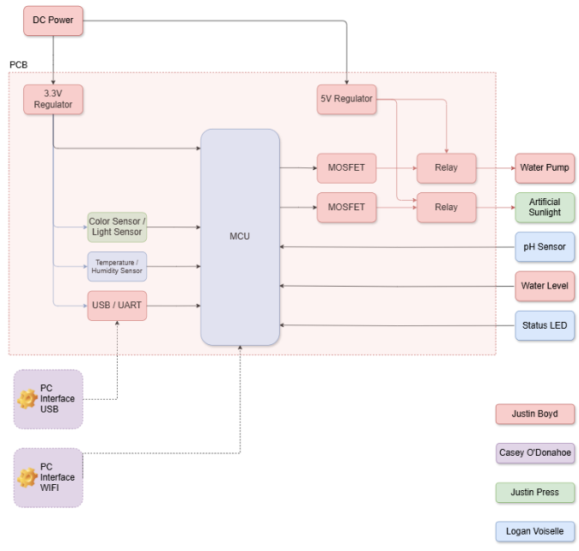
Hardware Block Diagram

Slide 9
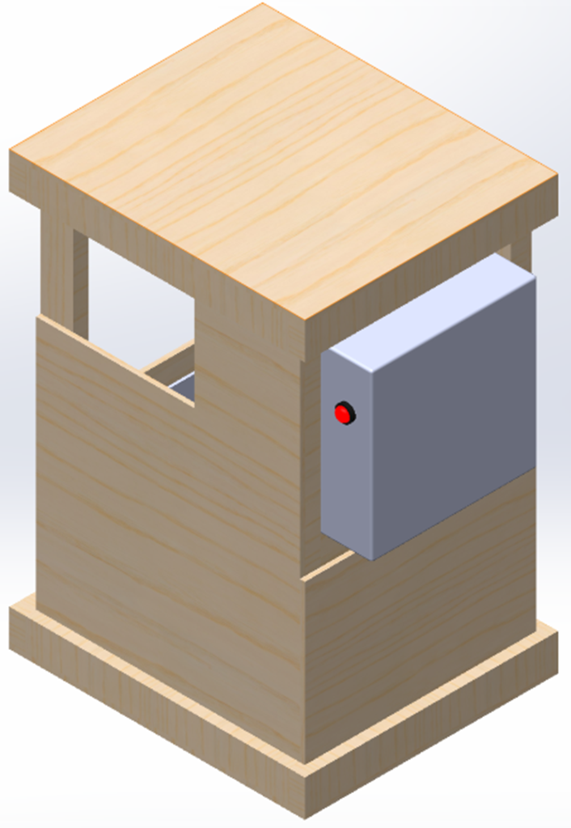
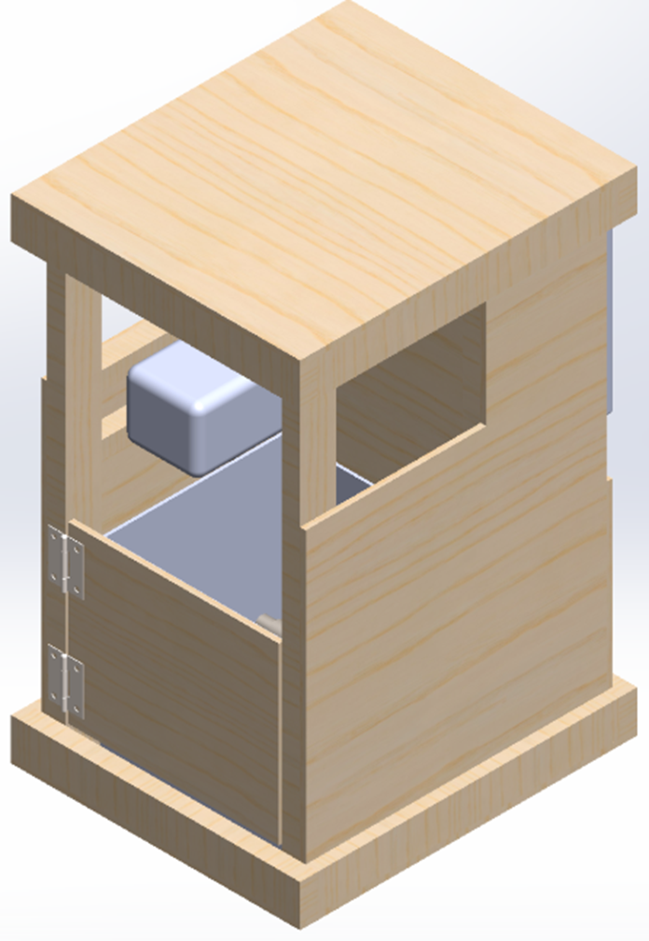
Hardware Design
Growth Acceleration System
  Artificial Sunlight LED
  Color Sensor
Plant Chamber
  Water Pump
  Environmental Sensors

Slide 10
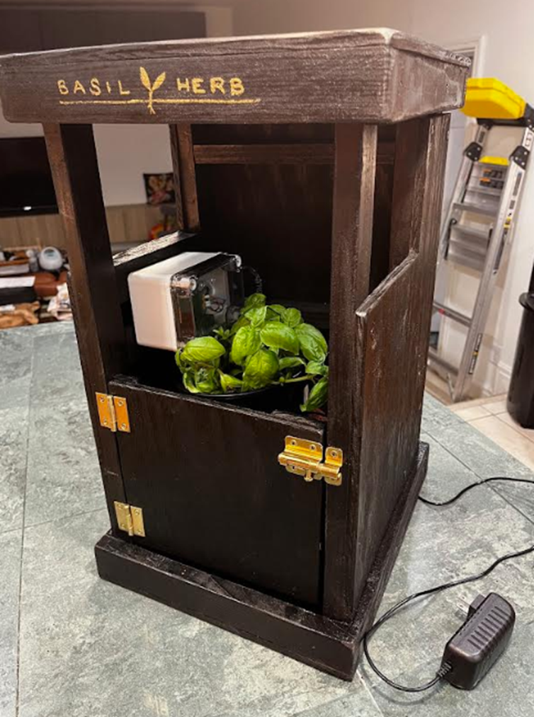
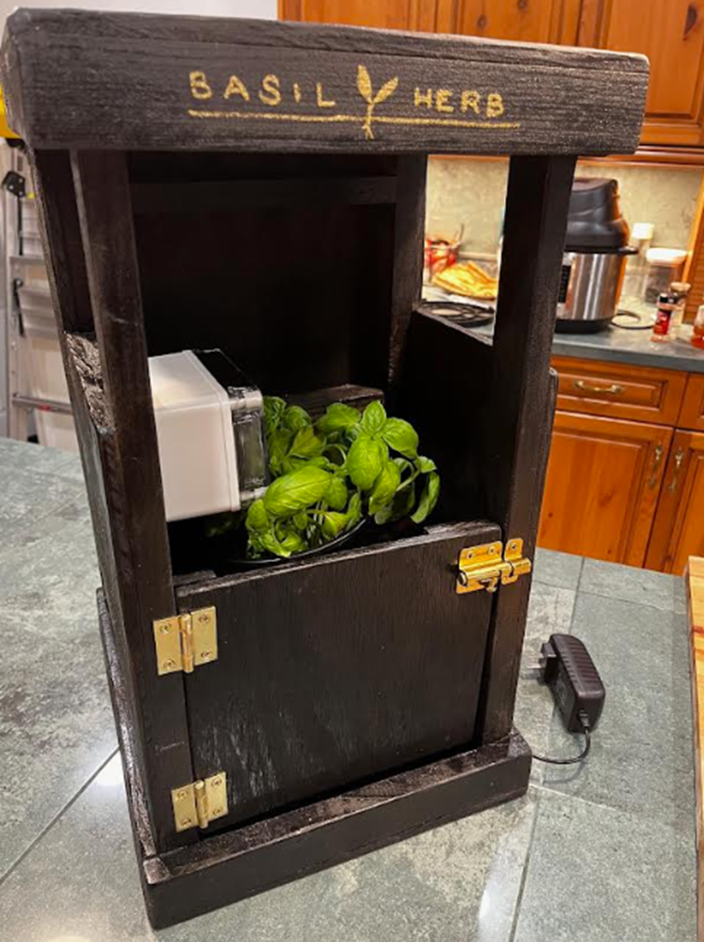
Hardware Design

Slide 11
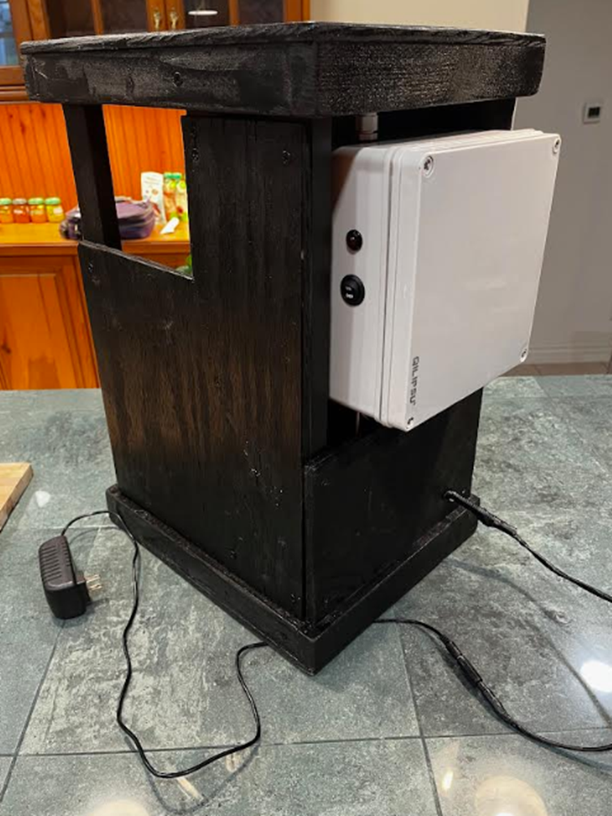
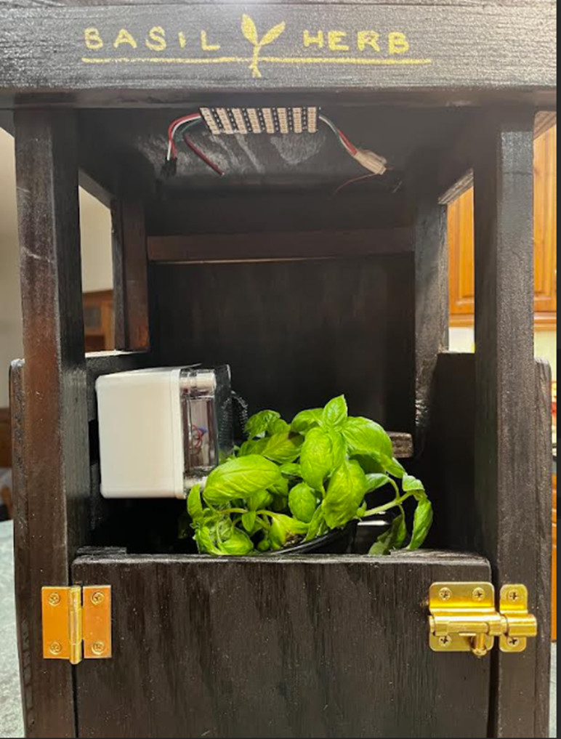
Hardware Design

Slide 12
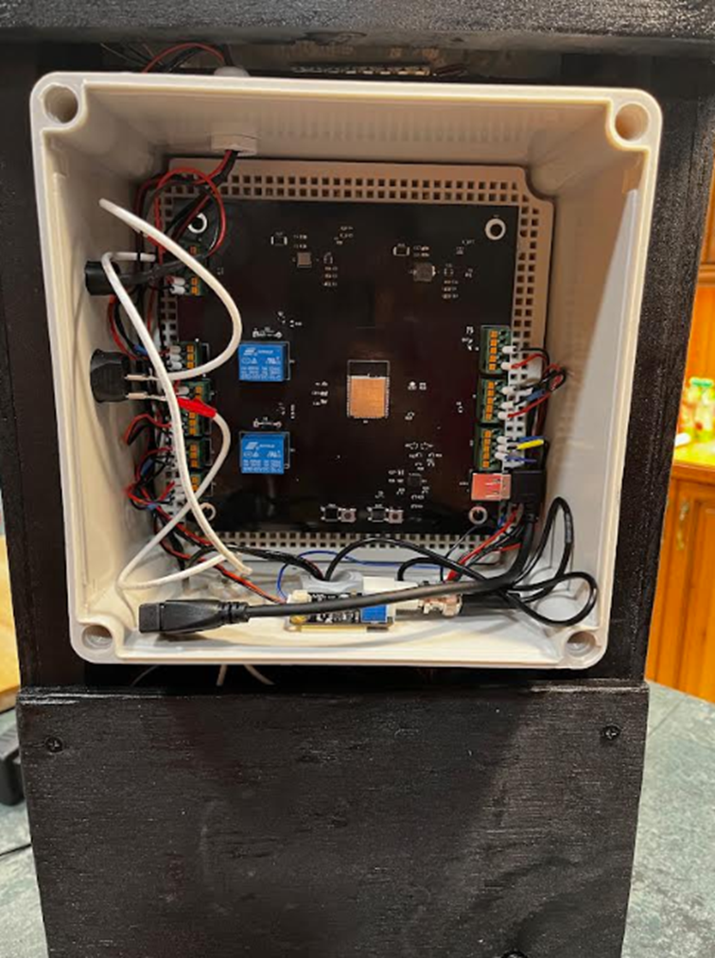
Hardware Design

Slide 13
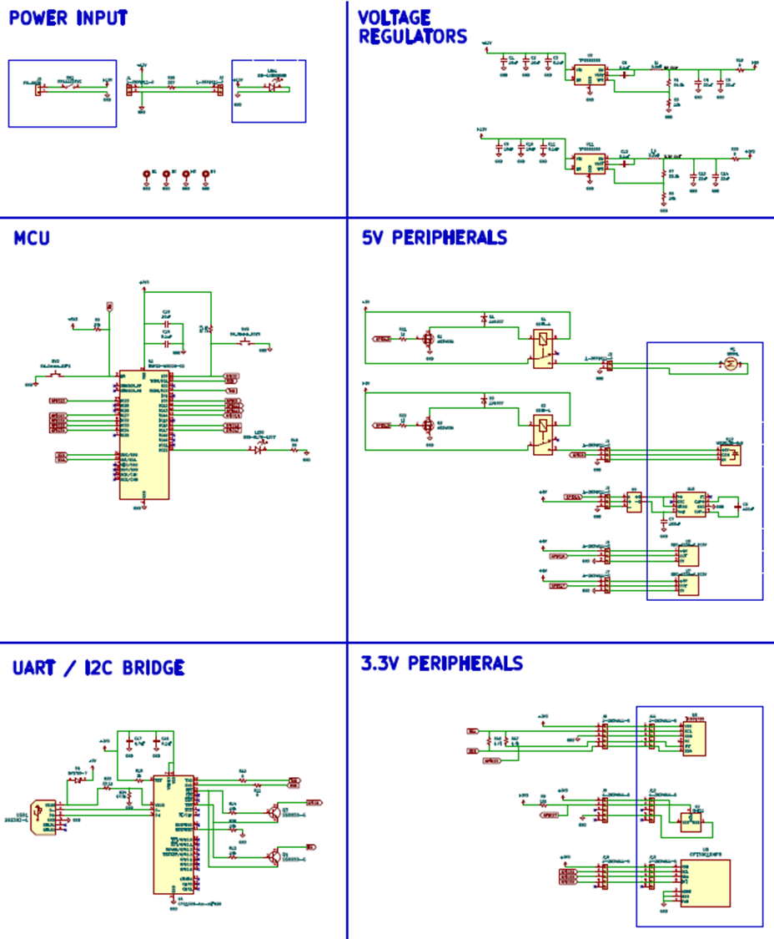
SCHEMATICS

Slide 14
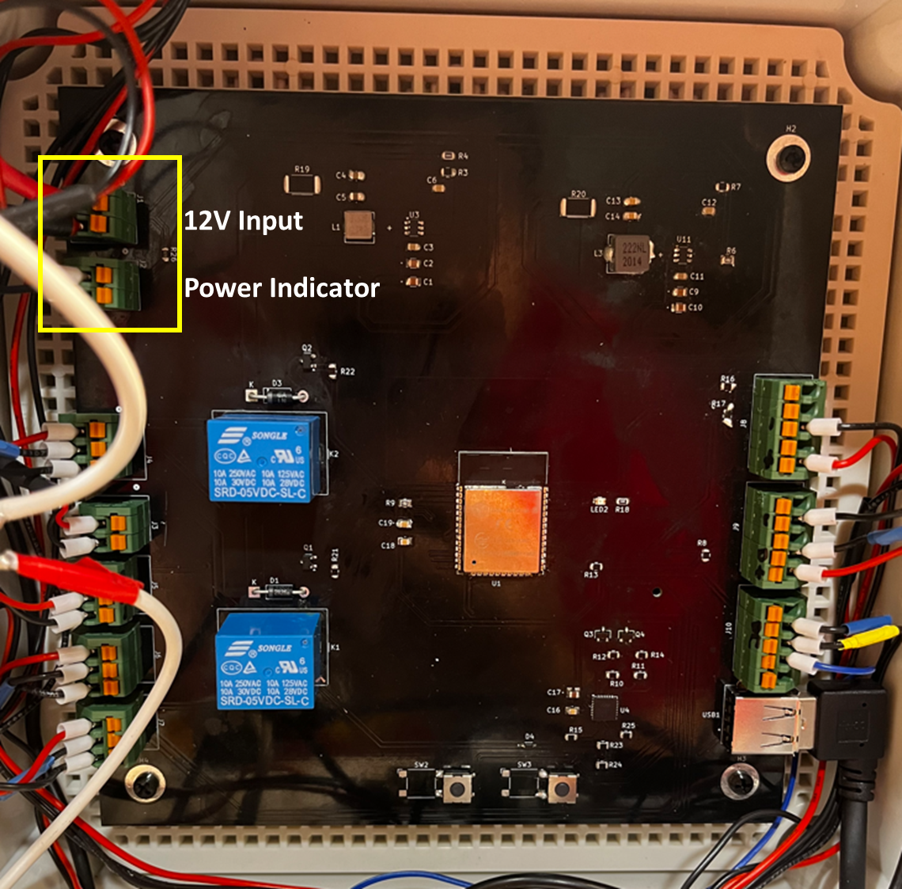
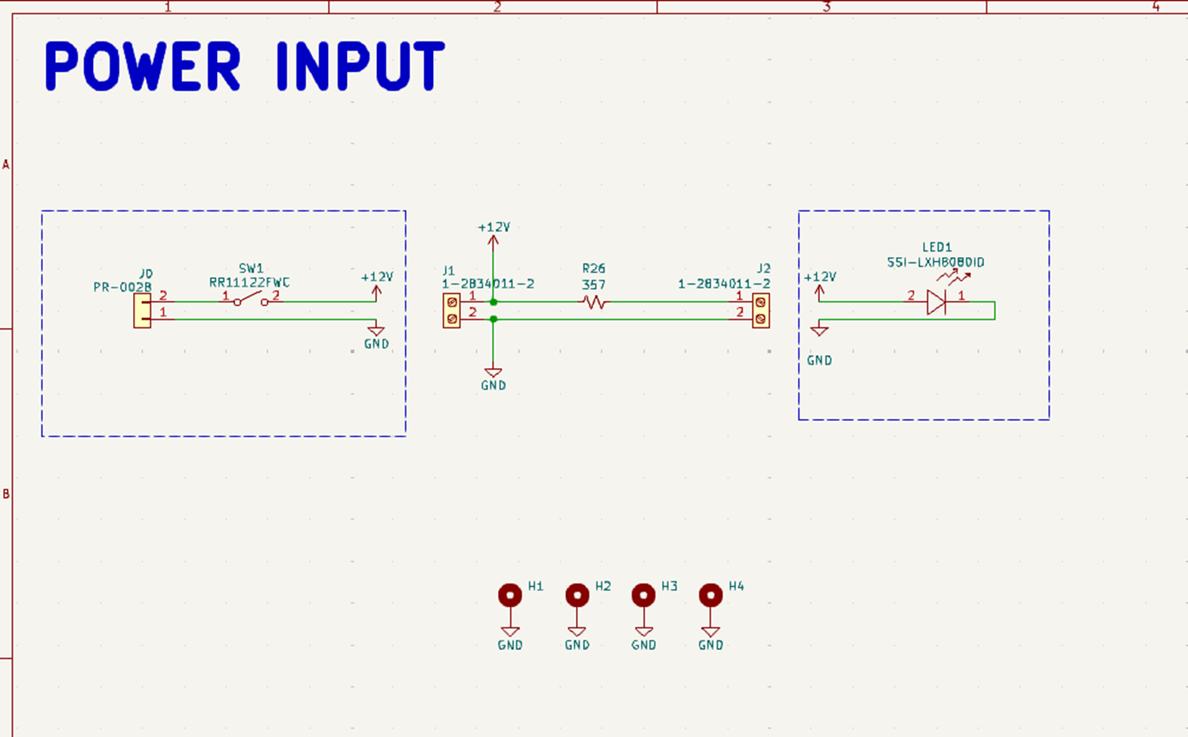
SCHEMATICS

Slide 15
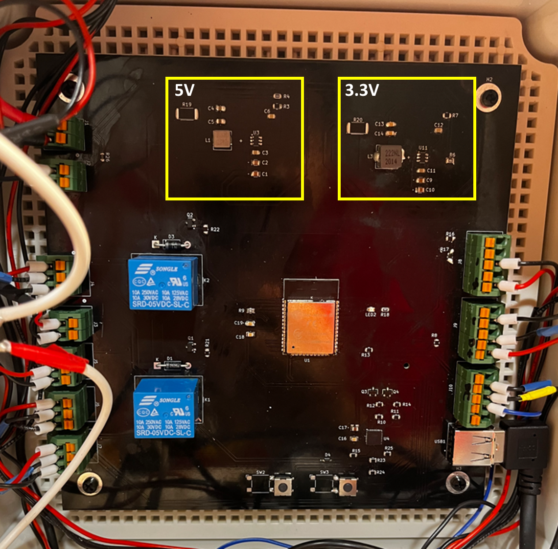
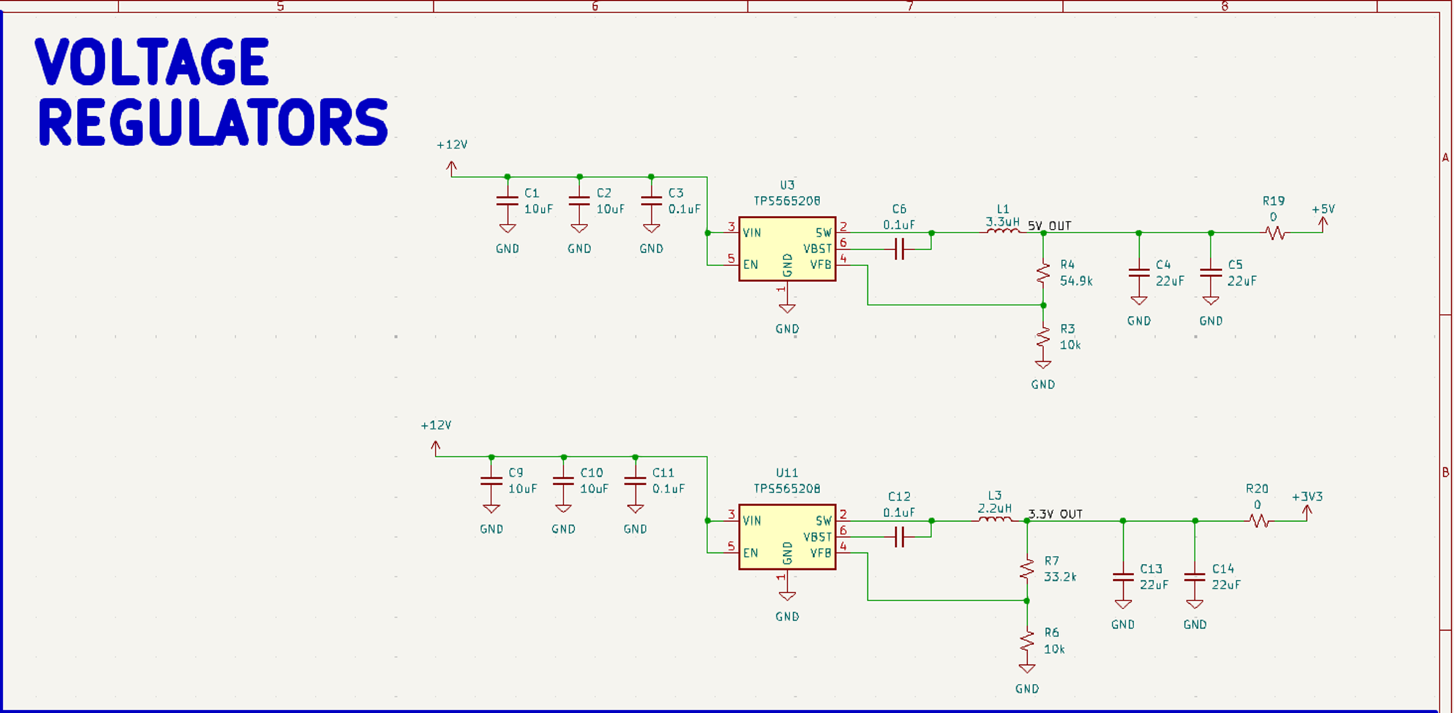
SCHEMATICS
Voltage Regulators
  5V Primary load
    Artificial sunlight = 2.6A
    Water Pump = 0.96A
  3.3V Primary load
    MCU = 0.24A

Slide 16
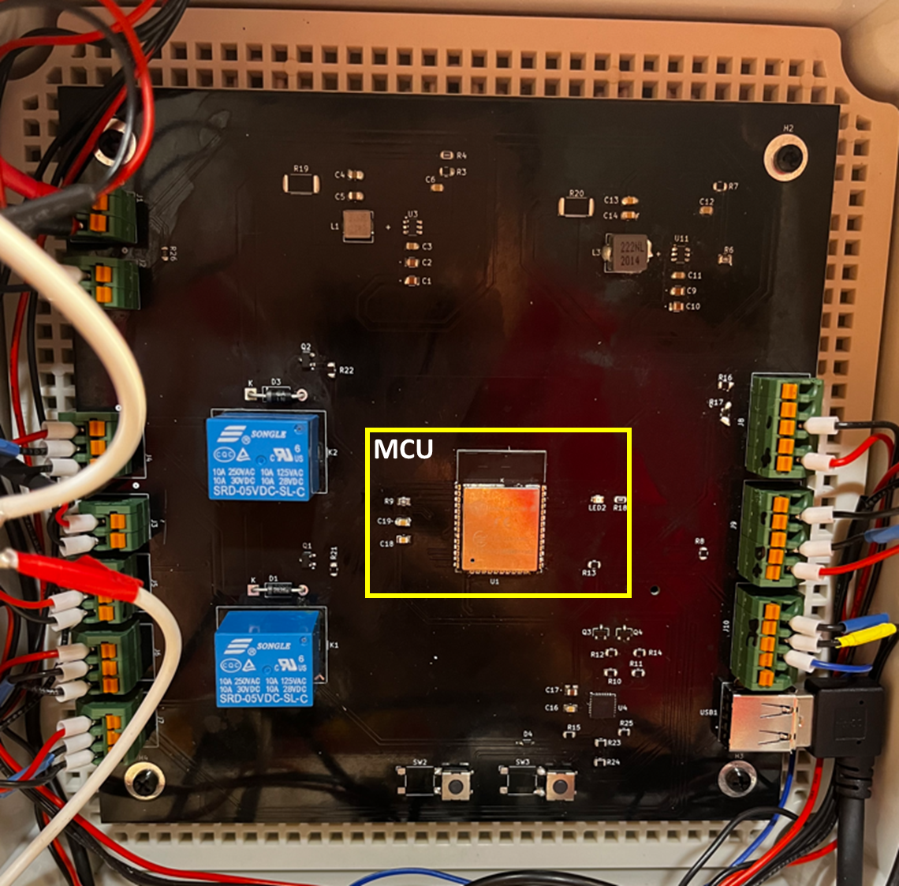
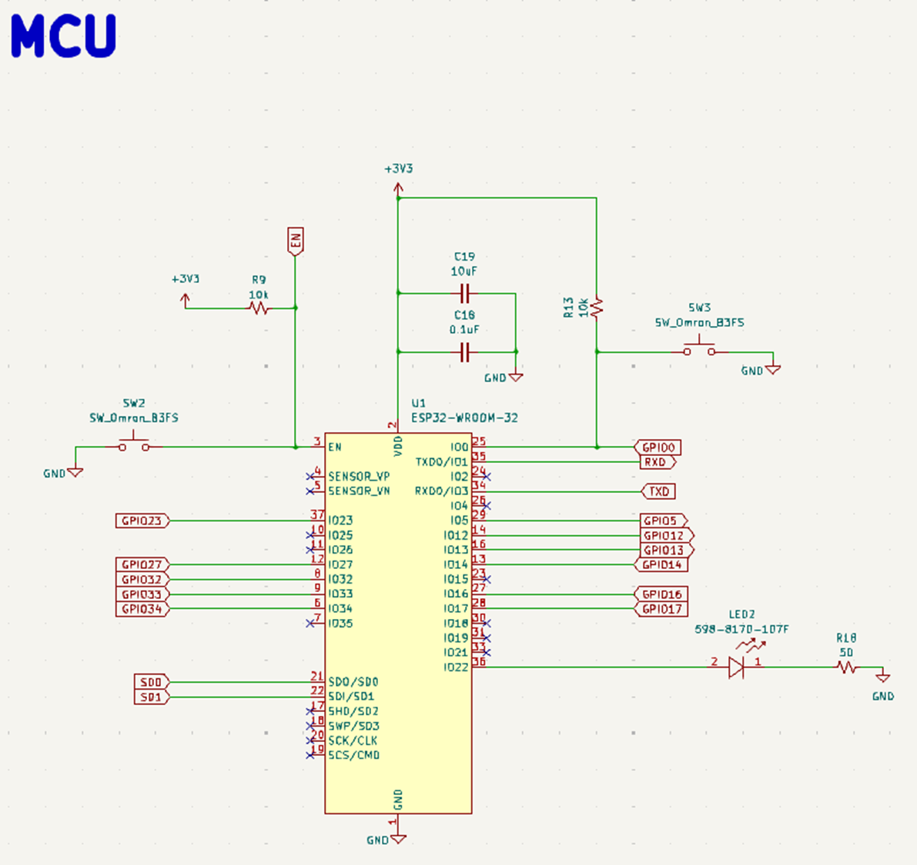
SCHEMATICS

Slide 17
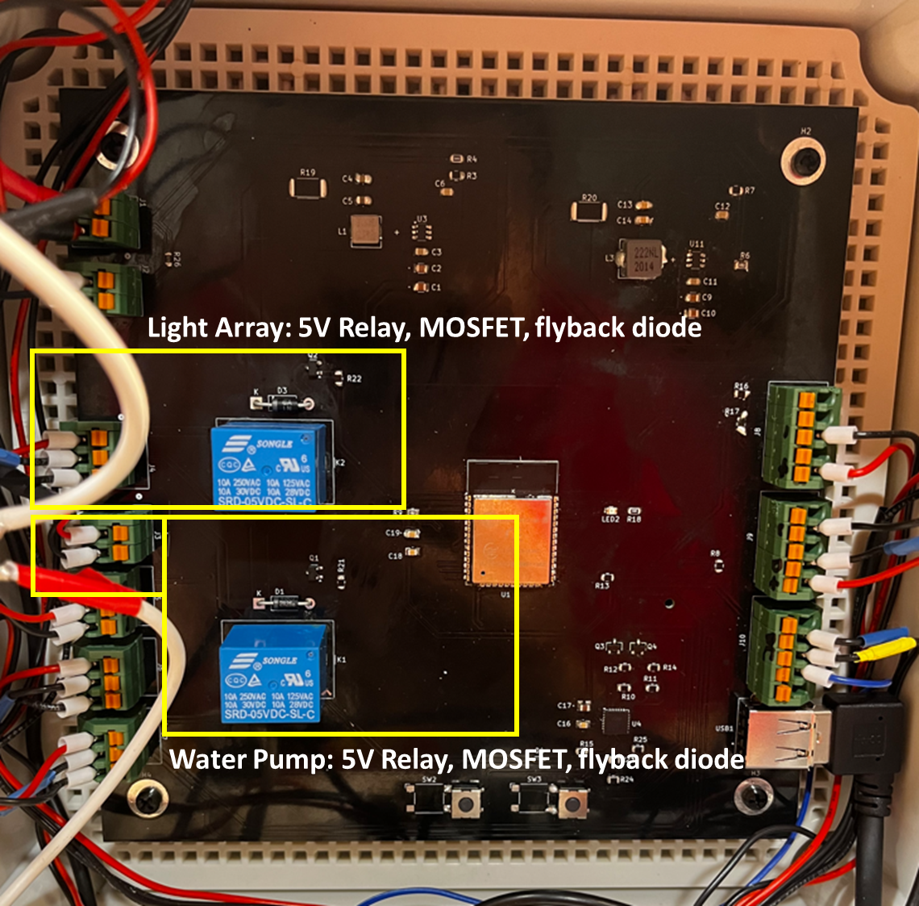
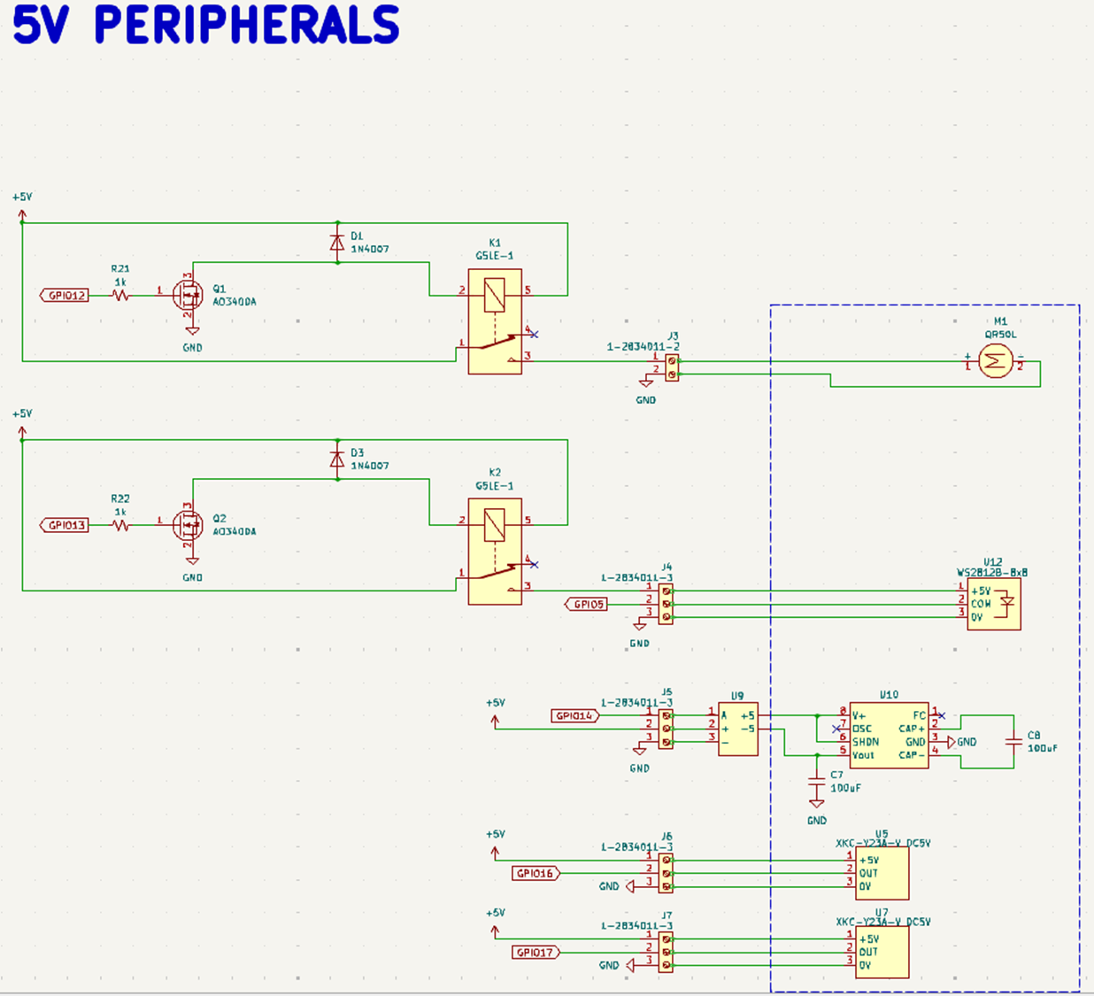
SCHEMATICS

Slide 18
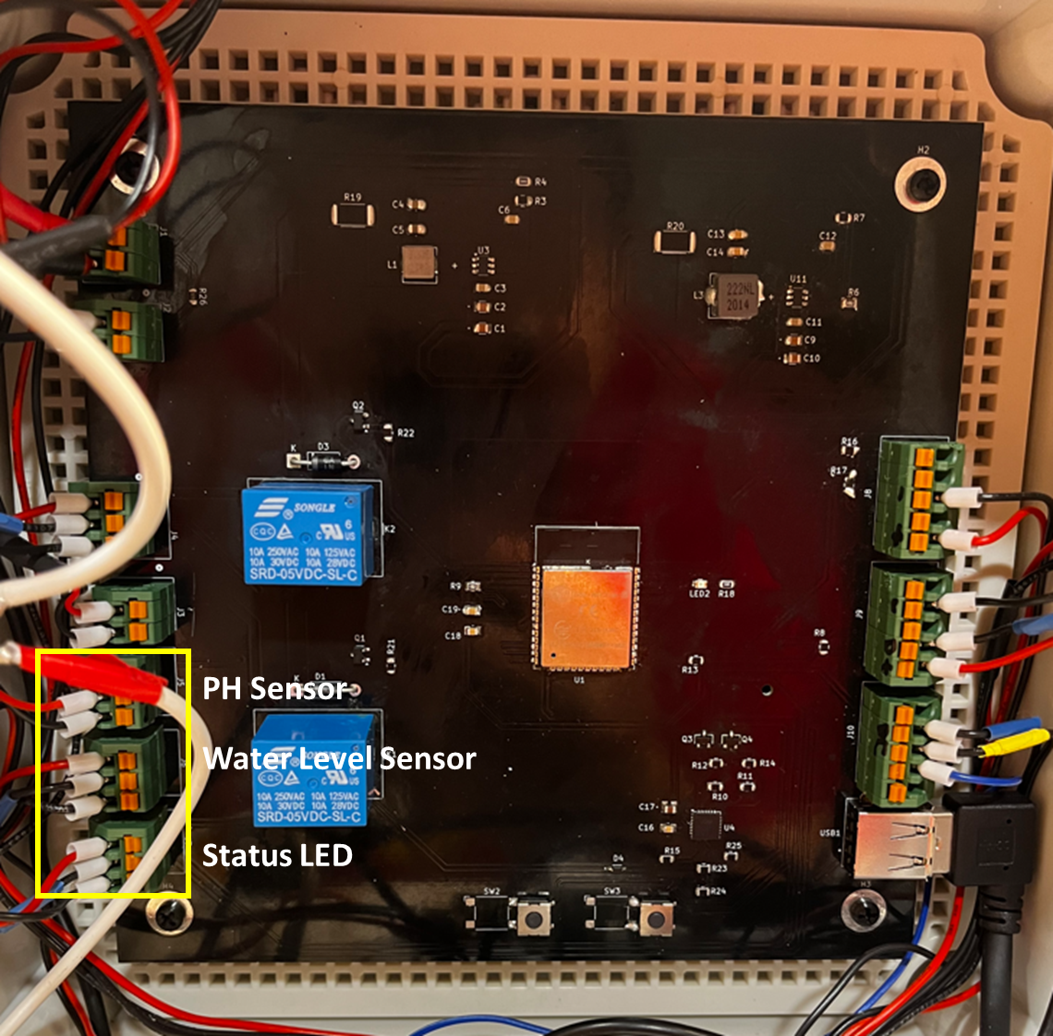
SCHEMATICS

Slide 19
SCHEMATICS

Slide 20
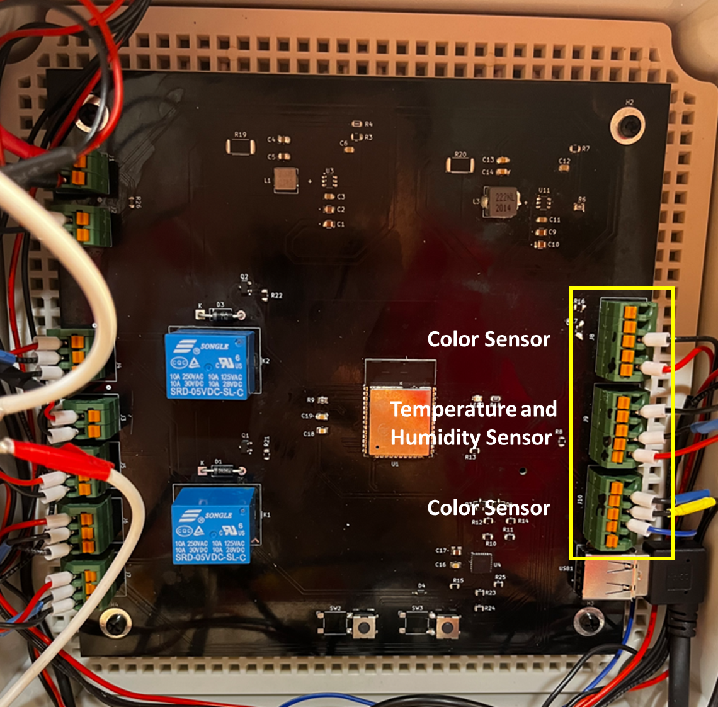
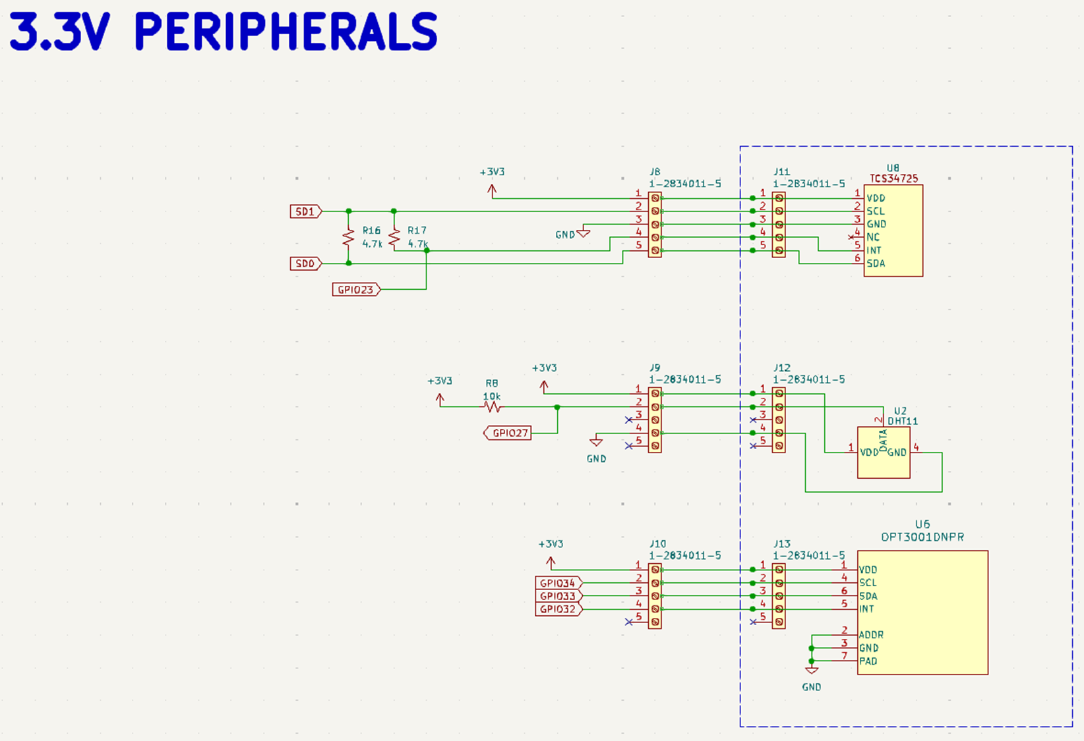
SCHEMATICS

Slide 21
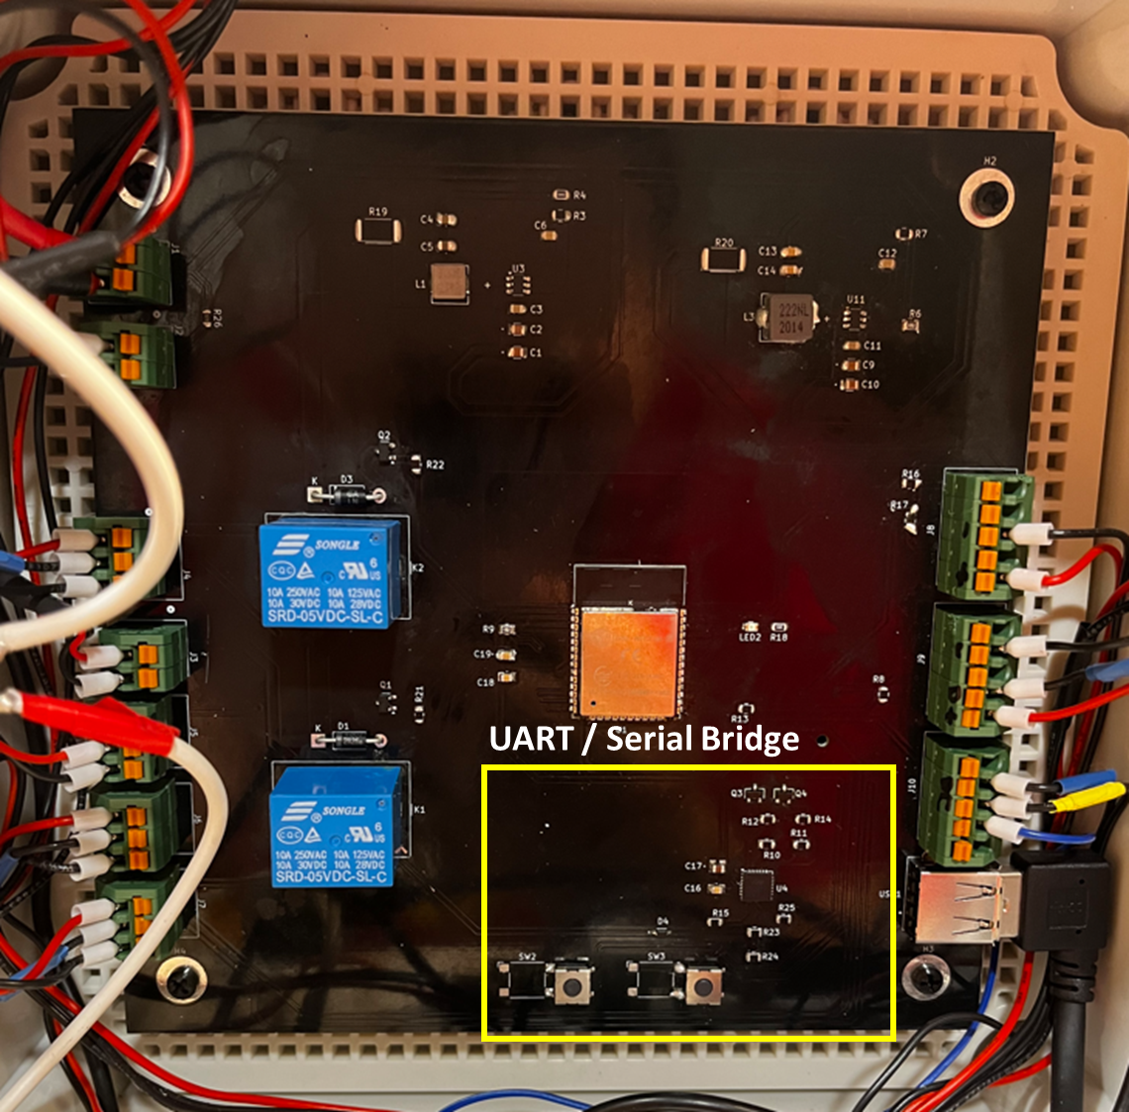
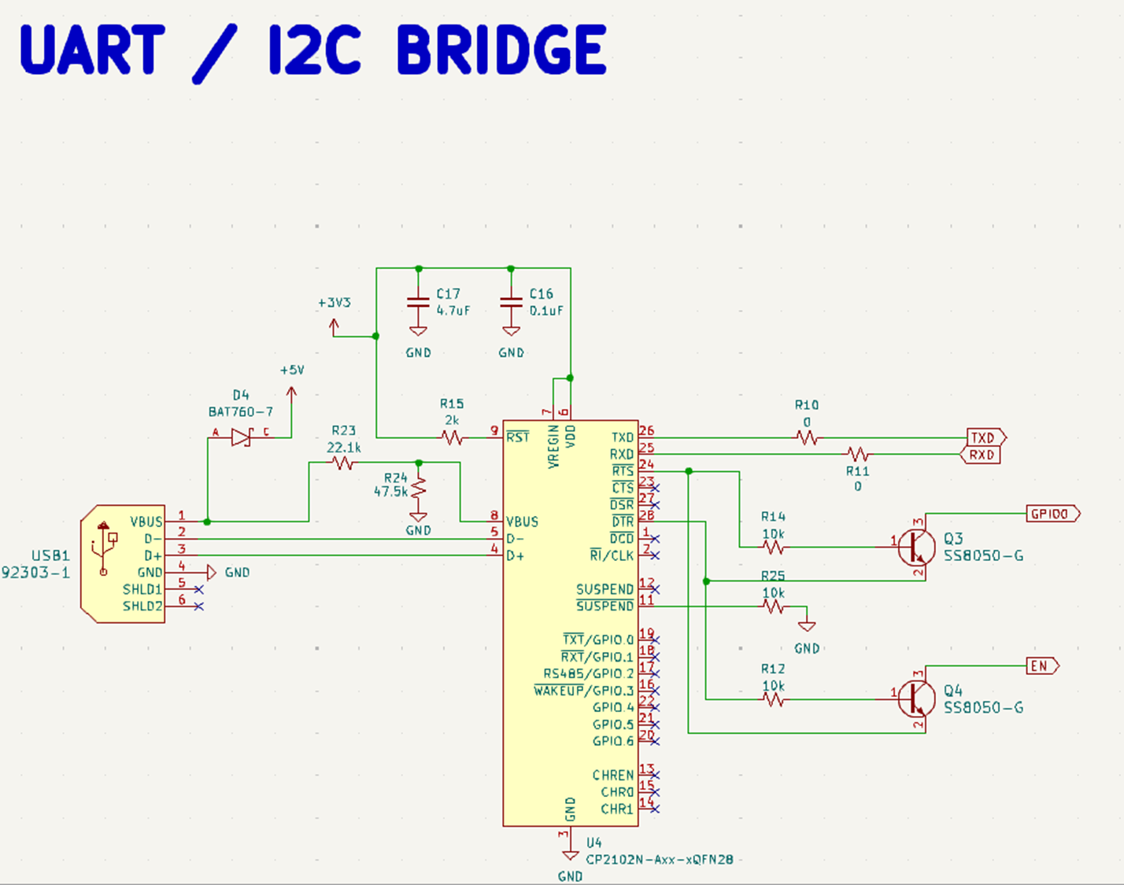
SCHEMATICS

Slide 22
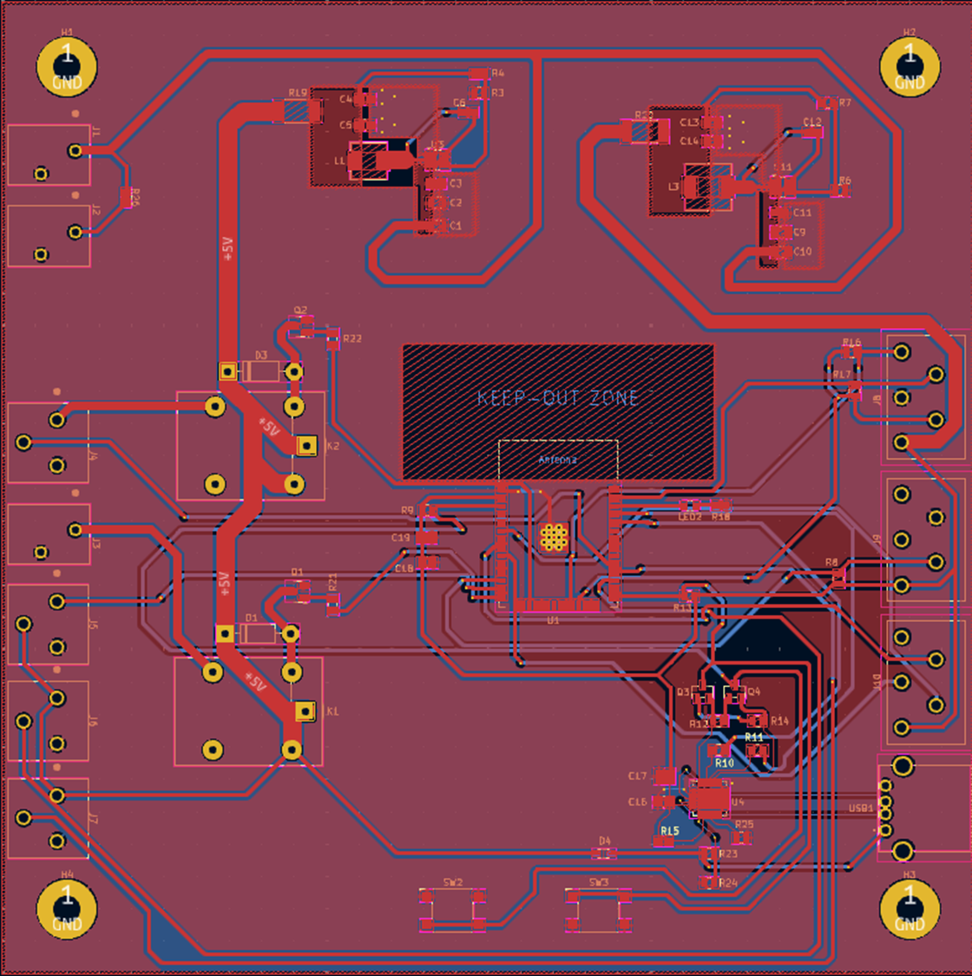
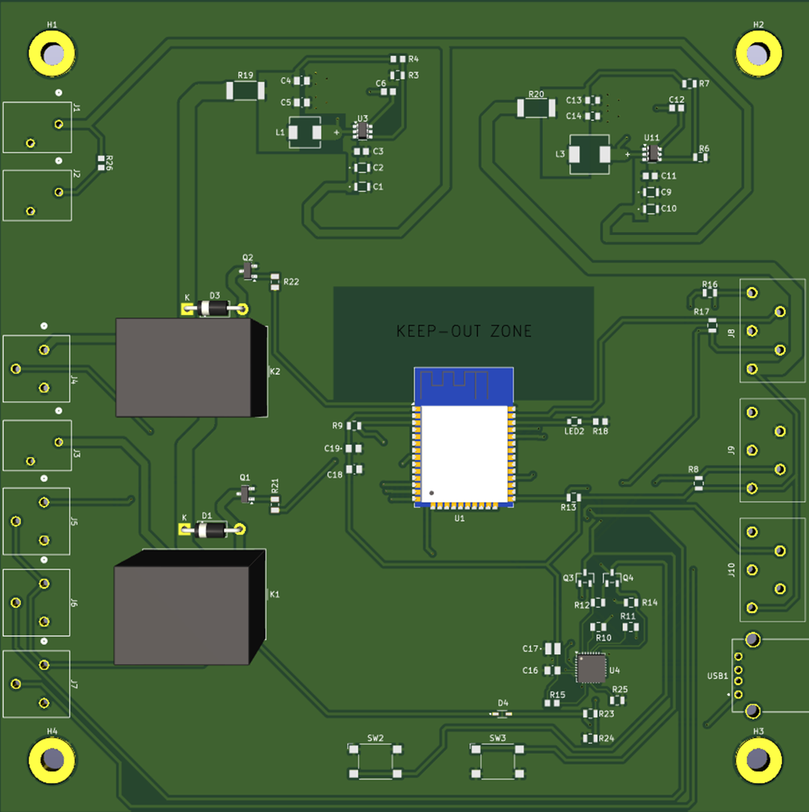
PCB Main Layout

Slide 23
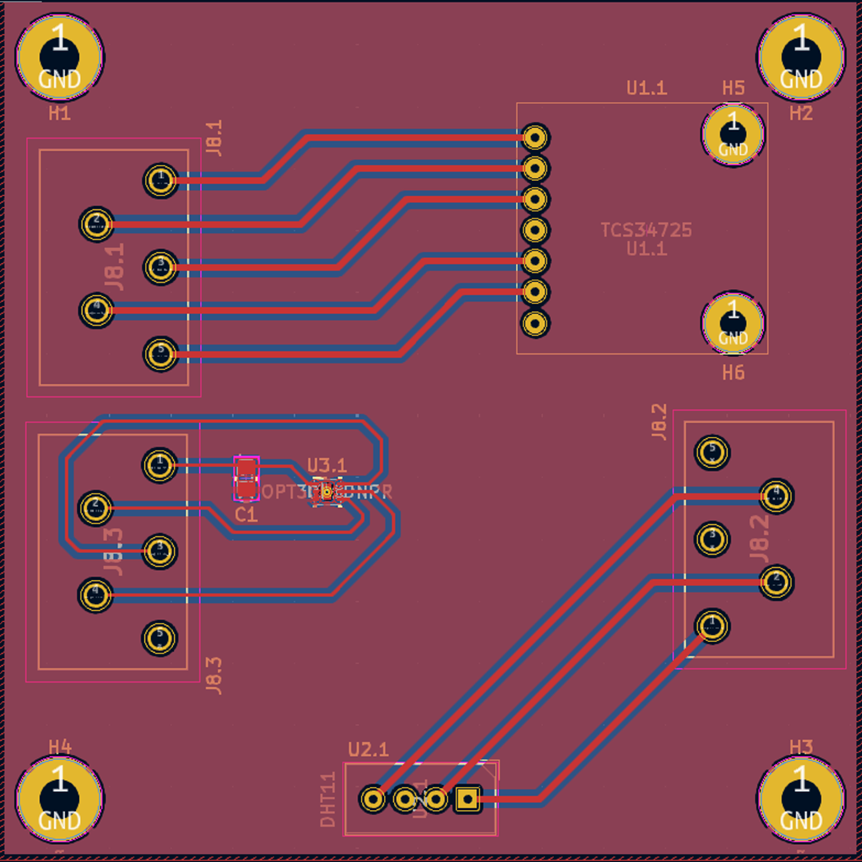
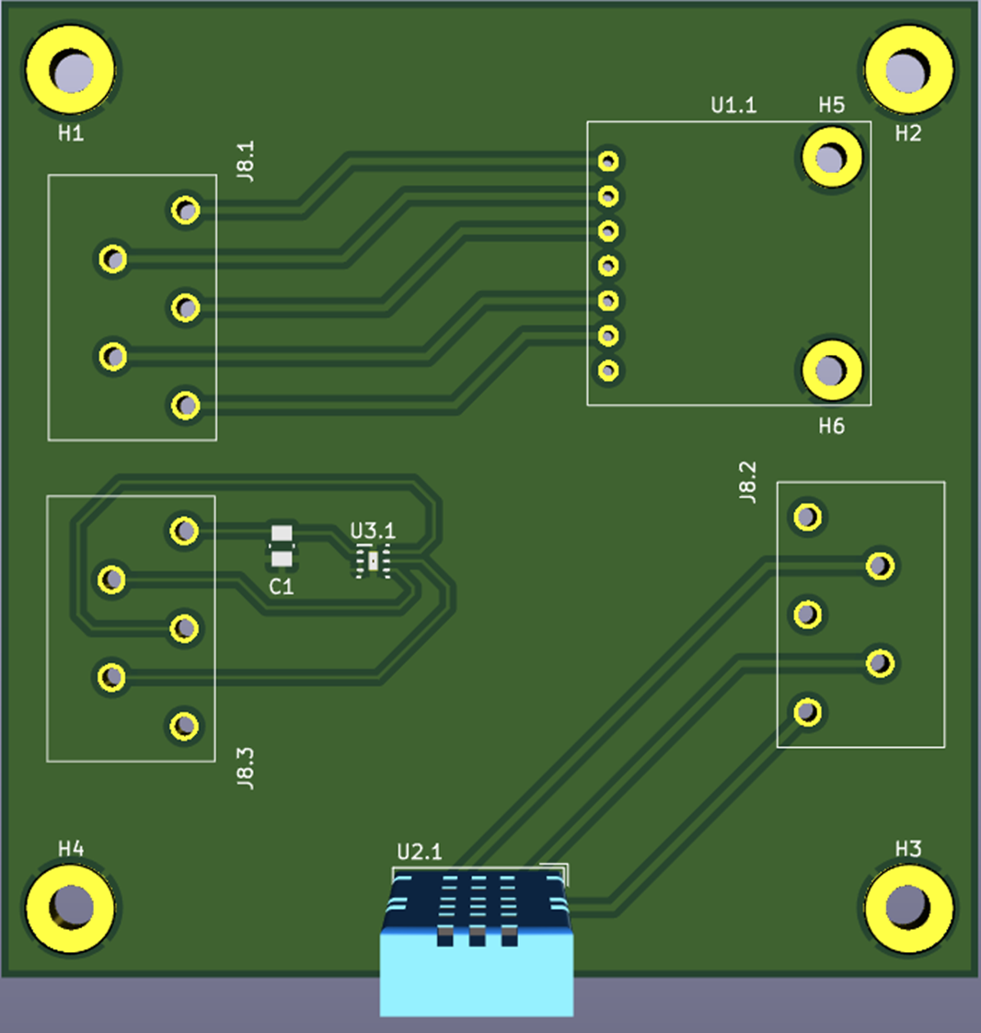
PCB Aux Layout

Slide 24
Microcontroller Selection
 | Arduino MKR 1000 | ESP32-WROOM-32 | ESP32-WROVER | ESP32-S2
Processor | 1GHz single-core | Dual-core 240 MHz | Dual-core 240 MHz | Single-core 240 MHz
RAM | 32 KB | 520 KB SRAM | 520 KB SRAM + 4 MB PSRAM | 320 KB SRAM
Wi-Fi | Yes | Yes | Yes | Yes
Bluetooth | Yes | Yes | Yes | No
GPIO Pins | 8 | 26 | 26 | 32
Power Consumption | 0.231-1.056W | 0.528-1.056W | 0.528-1.056W | 0.429-1.056W
Price | 5$ | 3$ | 7$ | 4$
Needs for MCU
- Bluetooth or wifi capabilities
- Reliable and Powerful
- Low energy
- Plenty of pins

Slide 25
Humidity/Temperature Sensor Selection
 | SHT31 | BME280 | Si7021 | DHT11
Accuracy | ±2% | ±3% | ±2% | ±5%
Operating Voltage | 2.4V - 5.5V | 1.8V - 3.6V | 1.9V - 3.6V | 3V - 5.5V
Sampling Rate | 2 Hz | 1 Hz | 0.5 Hz | 1 Hz
Interface | I2C | I2C/SPI | I2C | Single-wire digital
Response Time | < 8 seconds | < 1 second | < 10 seconds | < 6 seconds
Price | 6$ | 4.5$ | 5$ | 3$
Reasons for Selection:
- Fit all our design constraints and engineering requirements
- Our group members had multiple of this sensor

Slide 26
PH Selection
 | Atlas Scientific pH Probe | Gravity Analog pH Sensor | SEN0161 Analog pH Meter | Vernier pH Sensor
Accuracy | ±0.002 pH | ±0.1 pH | ±0.1 pH | ±0.1 pH
Response Time | < 1 second | < 30 seconds | < 30 seconds | < 1 second
Maintenance Requirements | Weekly | Bi-Weekly | Monthly | Quarterly
Durability | 18 months | 12-18 months | 12-24 months | 24-36 months
Price | 50$ | 30$ | 40$ | 80$
Reasons for Selection:
- Balanced price with performance
- Lasts long without need of maintenance in comparison to most other sensors

Slide 27
Color Sensor Selection
 | AMS TCS3472 | APDS-9960 | ISL29125 | TCS34725 | TCS3200
Color Range | 16.7M colors | 16-bit RGB | 16-bit RGB | 16.7M colors | RGB + Clear
Resolution | 16-bit per channel | 8-bit per channel | 12-bit per channel | 16-bit per channel | 8-bit per channel
Operating Voltage | 2.7V - 3.3V | 2.4V - 3.6V | 2.3V - 3.6V | 2.7V - 3.6V | 2.7V - 5.5V
Supply Current | 0.325 mA | 0.790 mA | 0.500 mA | 0.235 mA | 2.0 mA
Size | 2.0 x 2.4 x 1.0 mm | 3.94 x 2.36 x 1.35 mm | 2.1 x 2.0 x 0.7 mm | 2.4 x 2.4 x 0.7 mm | 4.0 x 4.0 x 1.0 mm

Slide 28
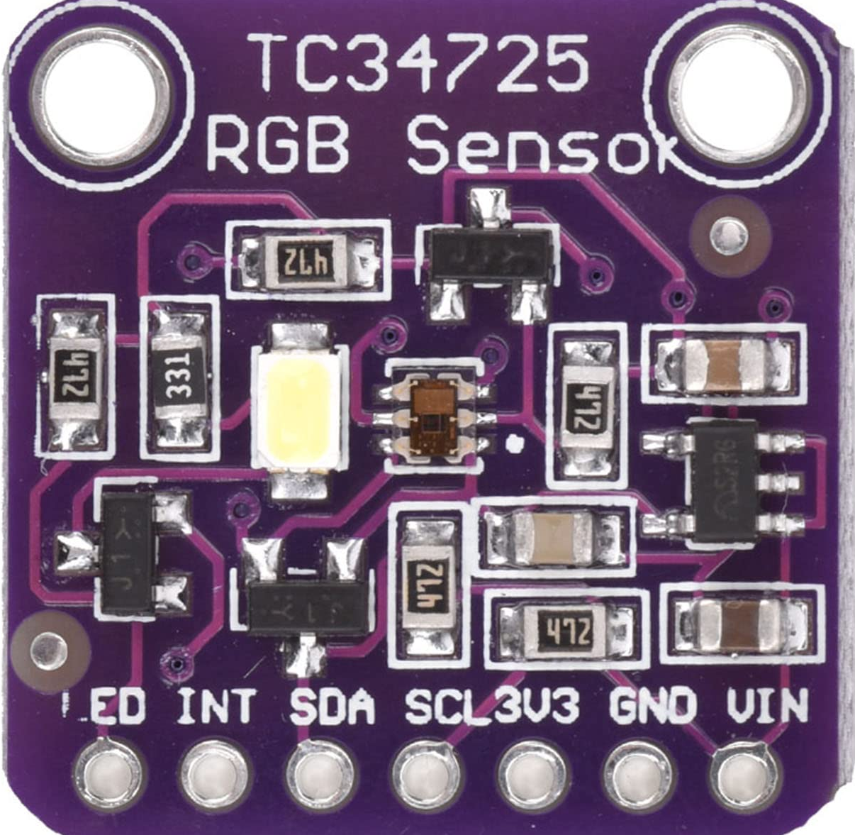
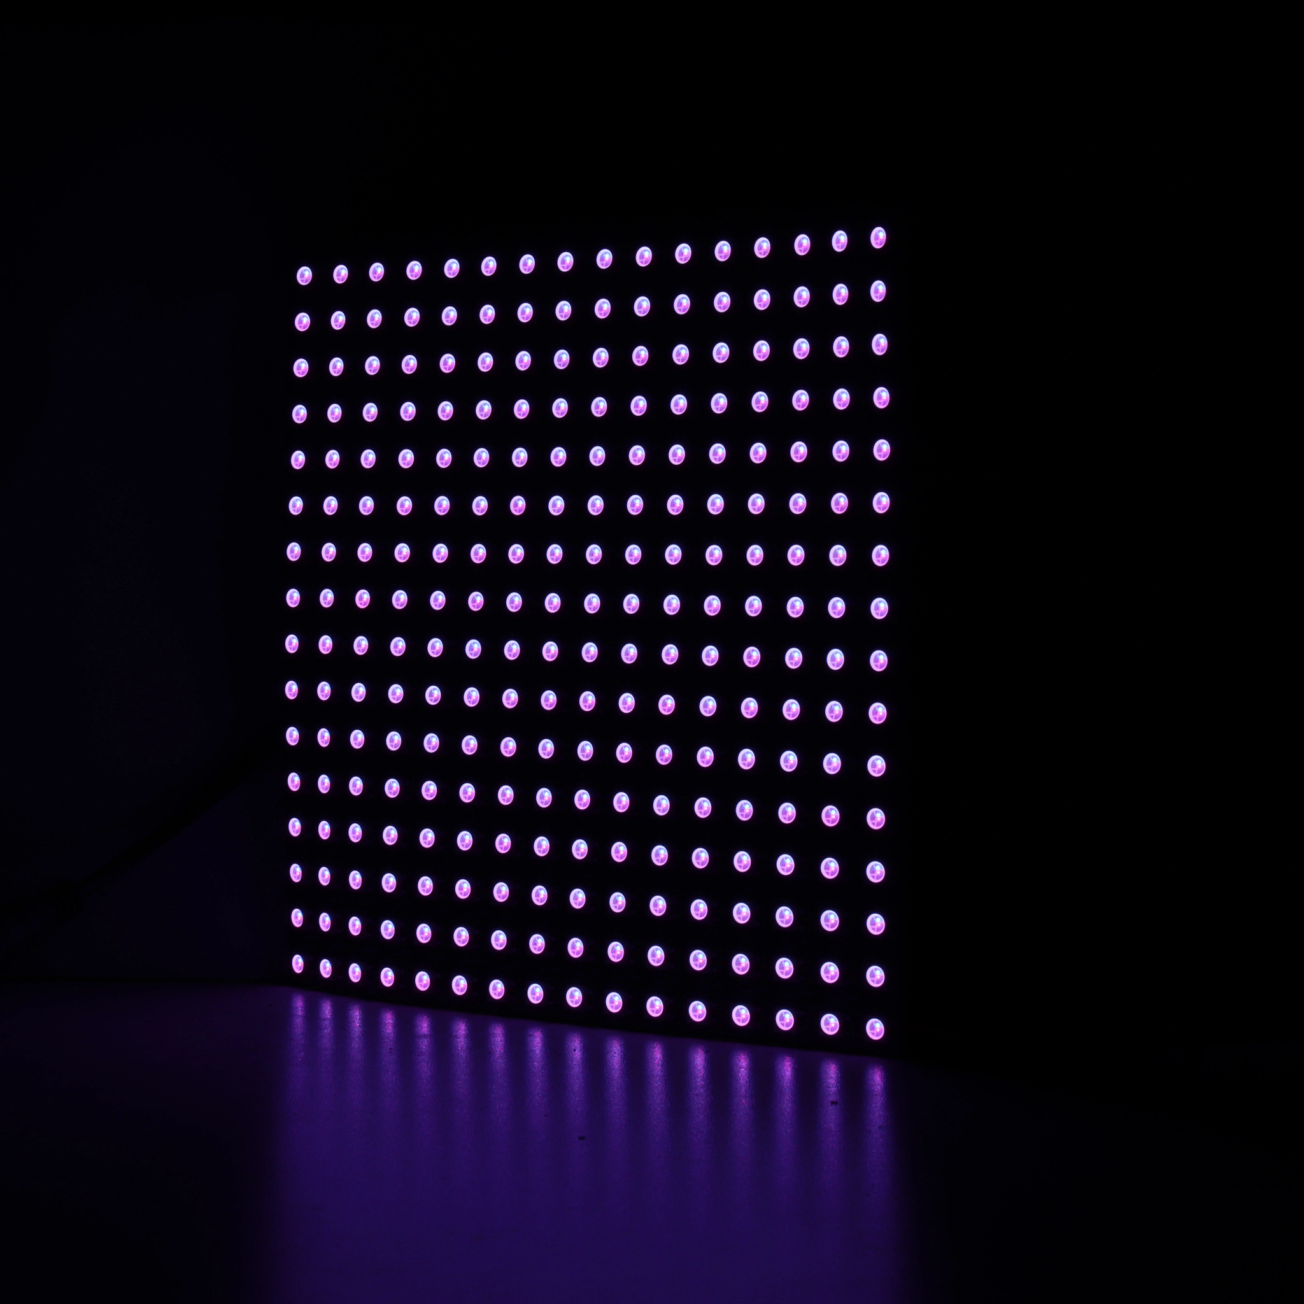
Lighting System
System Components
LED Grid Matrix Display
TCS34725 Color Sensor
Microcontroller Interface
Key Features
16.7M Color Detection
Real-time Color Sampling
Adaptive Brightness Control
Dynamic Light Patterns

Slide 29
Cloud Deployment Selection
 | Amazon Web Services (AWS) | Microsoft Azure | Digital Ocean | Google Cloud Platform (GCP)
Pricing | Expensive (Pricing depends on usage, pay as you go mode, this project estimate $10-$20 per month) | Moderate ($9 per month) | Cheap ($5 per month) | Moderate ($12 per month)
Support | Layers (24/7 support, Dedicated technician) | Layers (24/7 support, dedicated support team) | Layers (24/7 support, 1 hour response for teams) | Layers (24/7 support, technician, rapid response)

Slide 30
Back-end Framework Selection
 | Python (Flask) | JavaScript (Express) | .NET | Java (Apache) | Ruby | PHP
Development Time | 1-3 Days | 1- 3 Days | 3 - 5 Days | 3 - 5 Days | 1-3 Days | 2-4 Days
Security | Lacks | Moderate | Great | Great | Moderate | Moderate
Time to become proficient | 0 - 6 months | 0 - 6 months | 2 - 8 months | 2 - 8 months | 2 - 8 months | 4 - 10 months
*Scaled for a web developer with 0-2 years of experience

Slide 31
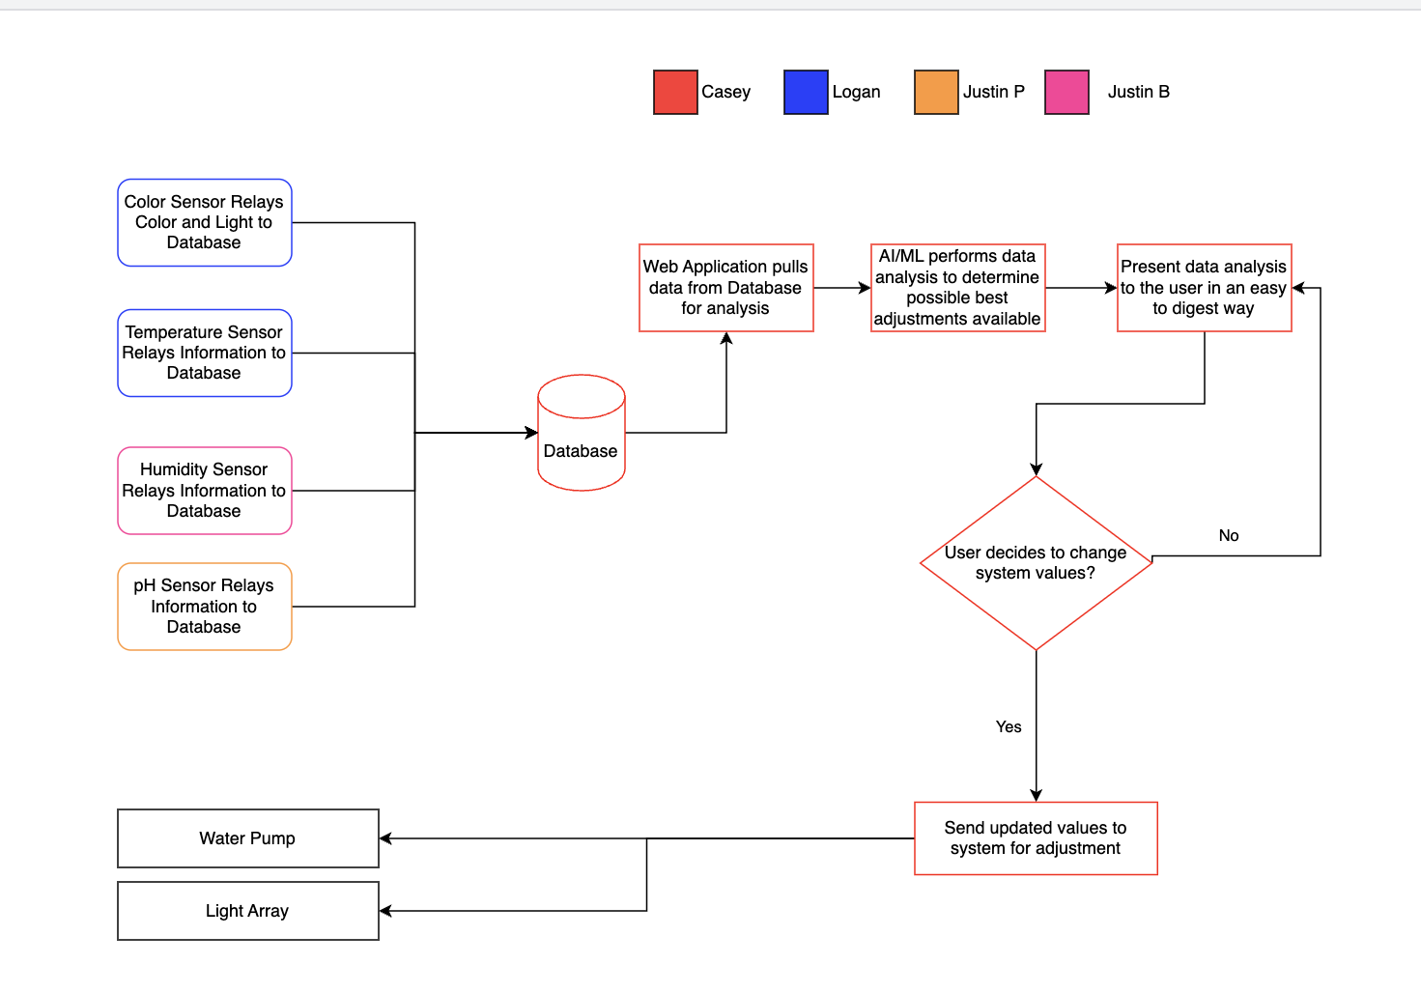
Back-end Framework Selection

Slide 32
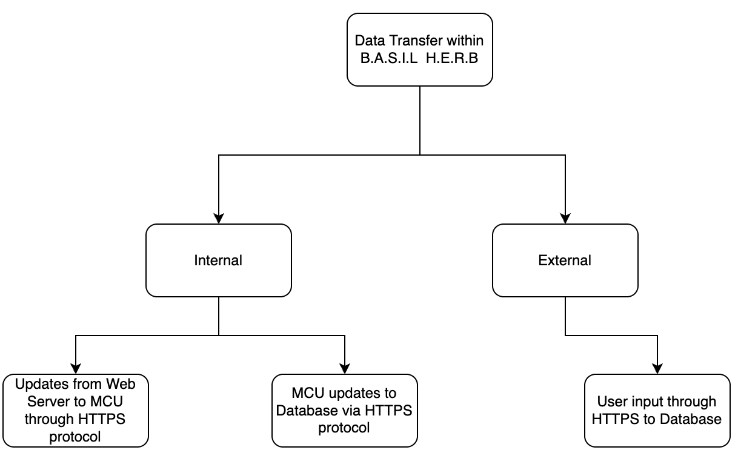
Software Design (Front-end + Database) Part 1

Slide 33
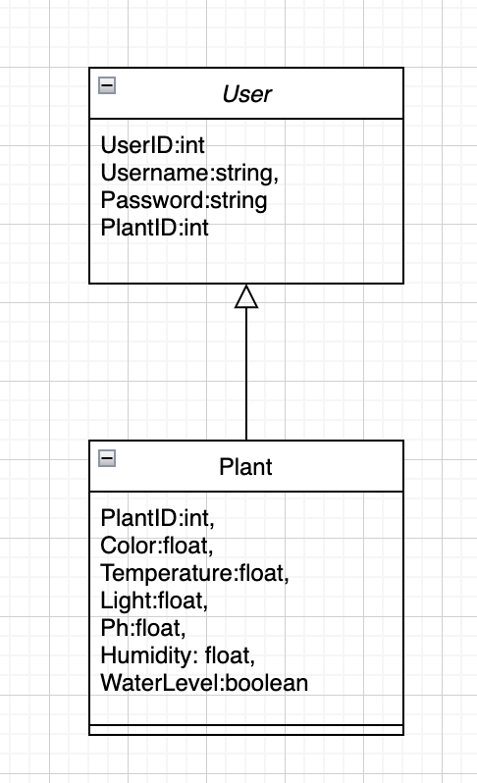
Software Design (Front-end + Database) Part 2

Slide 34
Software Design (Back-end 1/3)
User Table
UserID | Username | HashedPassword | PlantID
int | varchar(50) | varchar(250) | int
Measurement Table
PlantID | Humidity | Temperature | pH | Light | WaterLevel | Color
int | float | float | float | float | boolean | float
Threshold Table
PlantID | WaterPump | LightArray
int | boolean | boolean

Slide 35
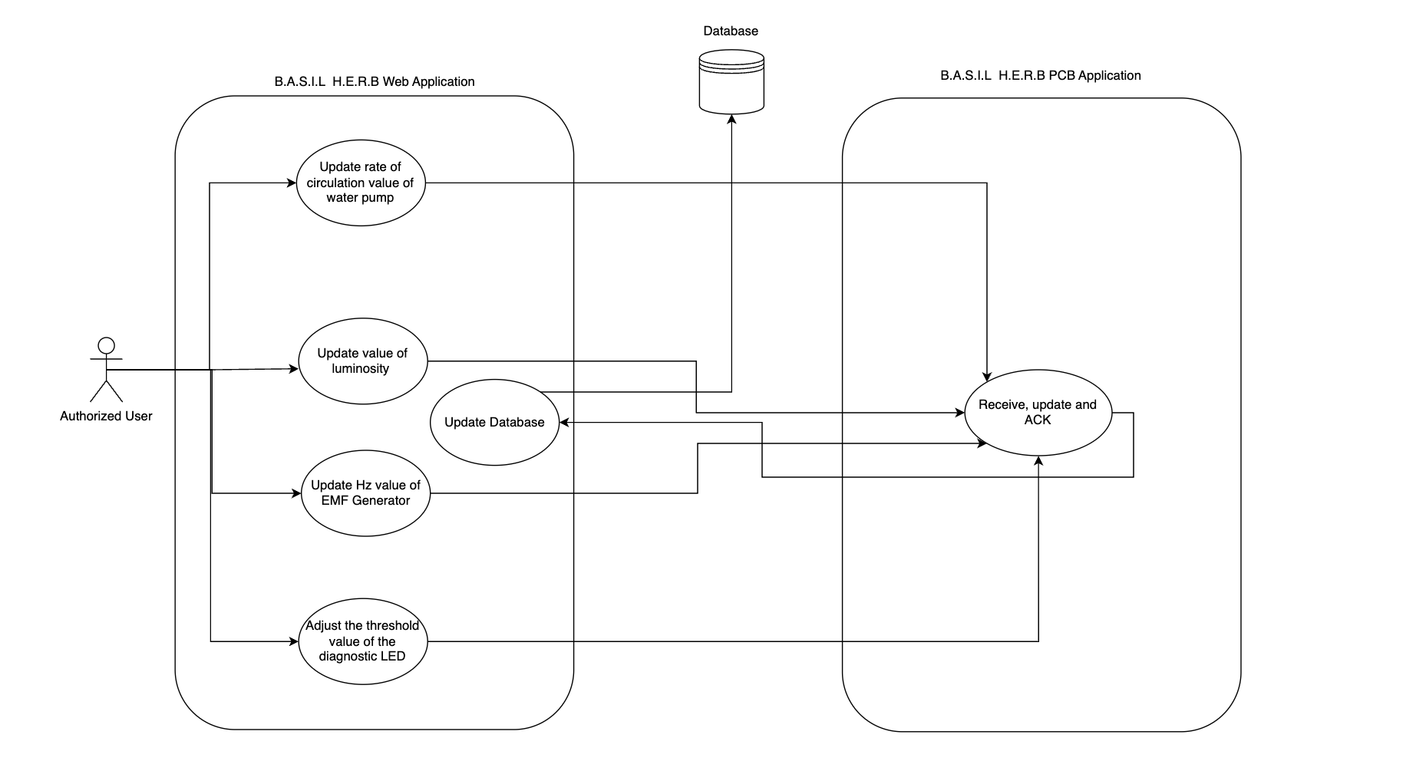
Software Design (Back-end 2/2)

Slide 36
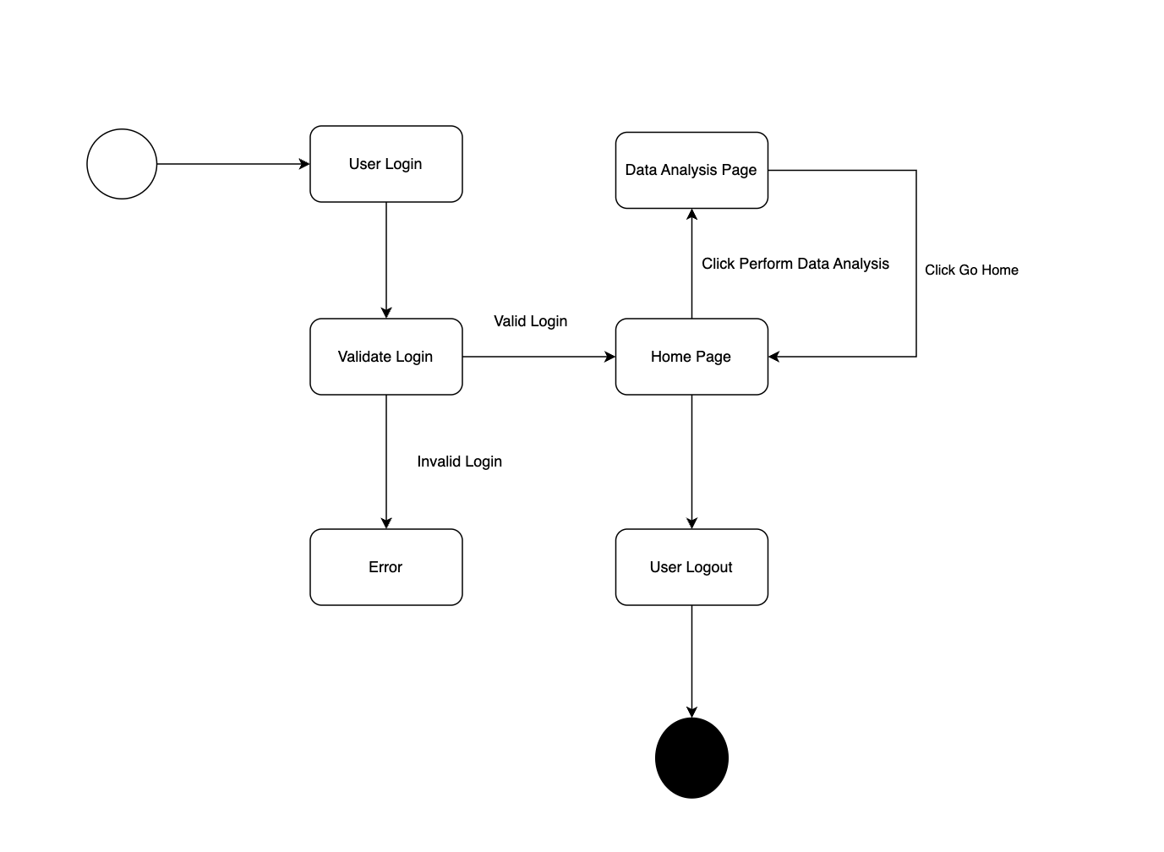
Software Design (Back-end 3/3)

Slide 37
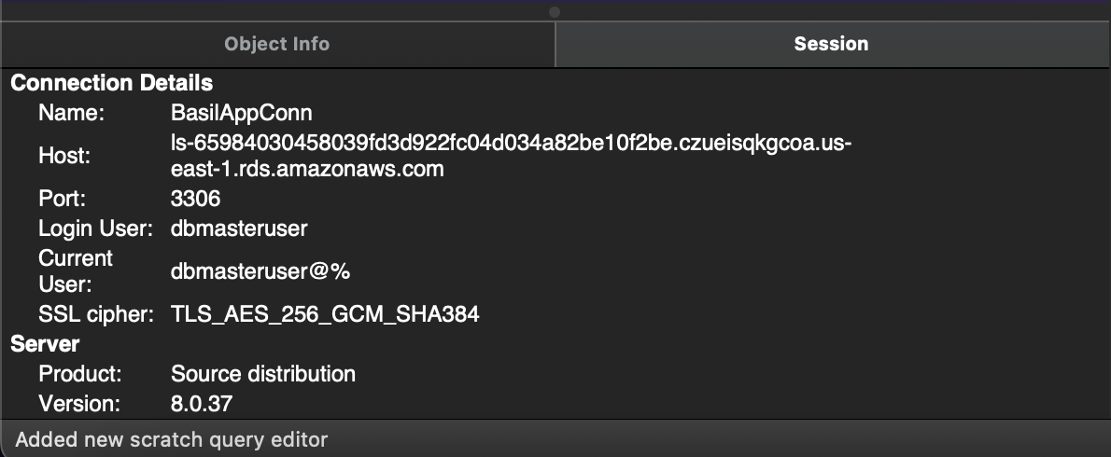
Software Design (Database Creation)

Slide 38
Project Issues
Color Sensor Readings
PH Readings
Integration with UCF WiFi
GPIO Pin Mapping
Sensor’s Dying
Voltage Regulators
Arduino IDE

Slide 39
Budget ($1,000)
Sub-system | Cost
Sensors, MCU and Motor | $101.97
Enclosure | $76.58
PCB Parts | $284.56
Lighting | $17.44
Software | $87.65
Miscellaneous | $91.70
Total | $659.90

